Slide 1
Like* Data
10-12-2020

Slide 2
Total English Words Spoken
Total Like
p=0.004, r=0.324
Quotative
p=0.059, r=0.217
Approximative
p=0.065, r=0.212
Discourse Marker
p=0.005, r=0.318
Discourse Particle
p=0.023, r=0.259
Notes:
cor.test(englishwords, one)
#p = 0.059
#r = 0.217
cor.test(englishwords, two)
#p = 0.065
#r = 0.212
cor.test(englishwords, three)
#p = 0.005
#r = 0.318
cor.test(englishwords, four)
#p = 0.023
#r = 0.259

Slide 3
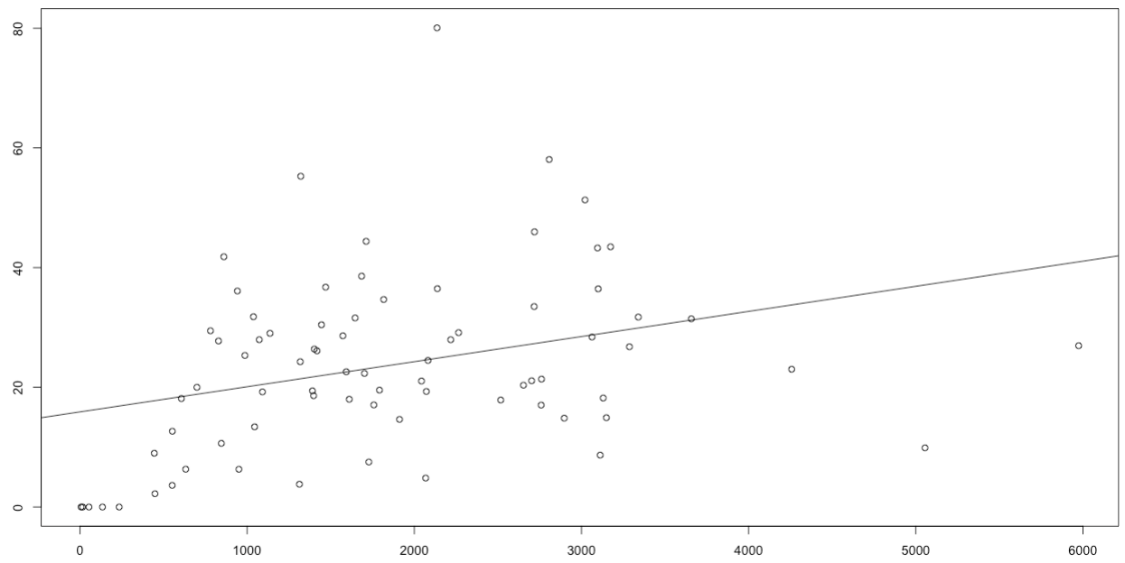
Total Like
Total English Words

Slide 4
Self-reported Proficiency of Other Lang (Read, Speak, Write, Understand) vs Total Like
Speak and Understand
p>.05
Read
p=0.008, r= -0.307
Write
p=0.0014, r= -0.367
Notes:
cor.test(total, otherread)
plot(total, otherread)
#p = 0.0081
#r = -0.307
cor.test(total, otherwrite)
#p = 0.0014
#r = -0.367

Slide 5
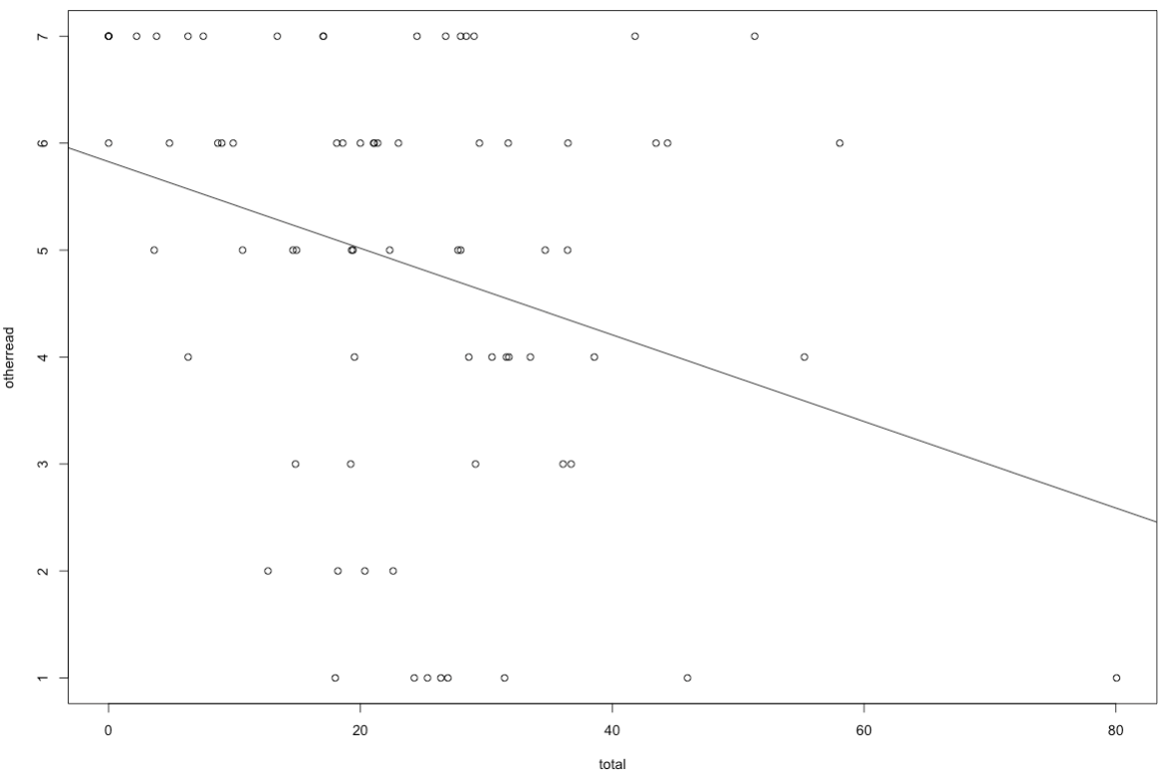
SR Reading Proficiency
Total English Words

Slide 6
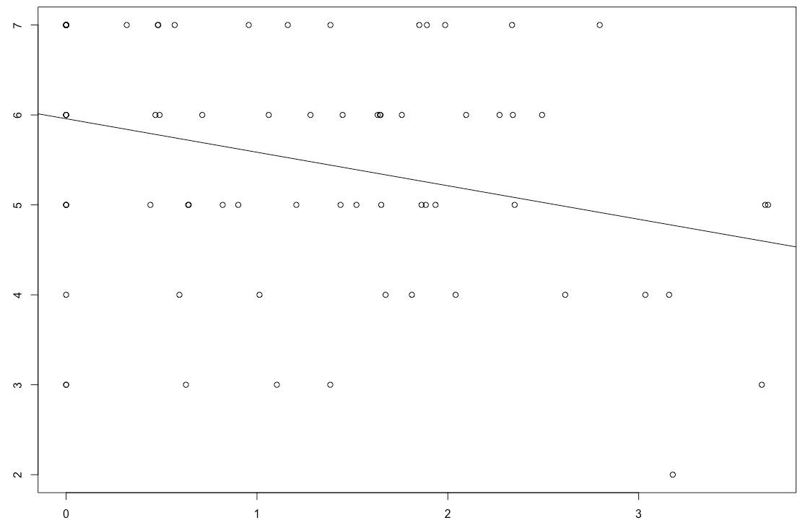
Self-reported Proficiency of Other Lang (Speak)
Quotative, DM, DP
p>.05
Approximative
p=0.01, r= -0.297
SR Other Speak
Approximative
Notes:
### Other Speak
cor.test(one, otherspeak)
cor.test(two, otherspeak)
#p = 0.01
#r = -0.297
cor.test(three, otherspeak)
cor.test(four, otherspeak)

Slide 7
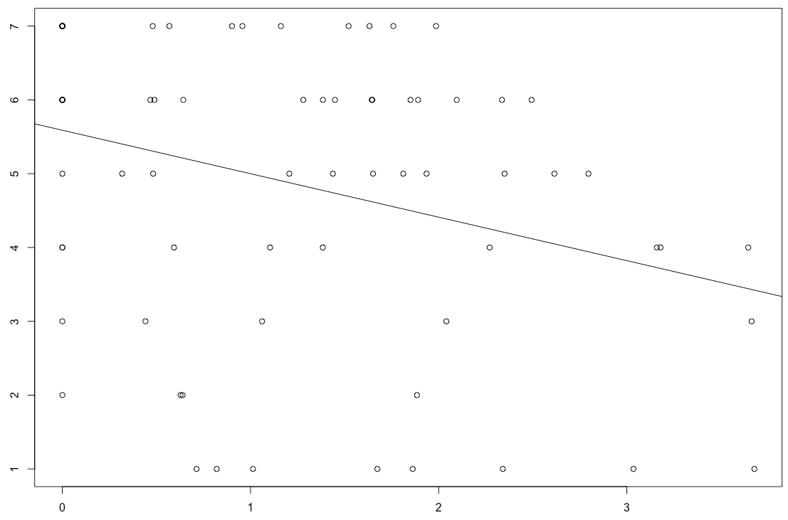
Self-reported Proficiency of Other Lang (Read)
Quotative
p>.05
Approximative
p=0.006, r= -0.315
Discourse Marker
p=0.012, r= -0.291
Discourse Particle
p=0.013, r= -0.289
SR Other Read
Approximative
Notes:
### Other Read
cor.test(one, otherread)
cor.test(two, otherread)
#p = 0.006
#r = -0.315
cor.test(three, otherread)
#p = 0.012
#r = -0.291
cor.test(four, otherread)
#p = 0.013
#r = -0.289

Slide 8
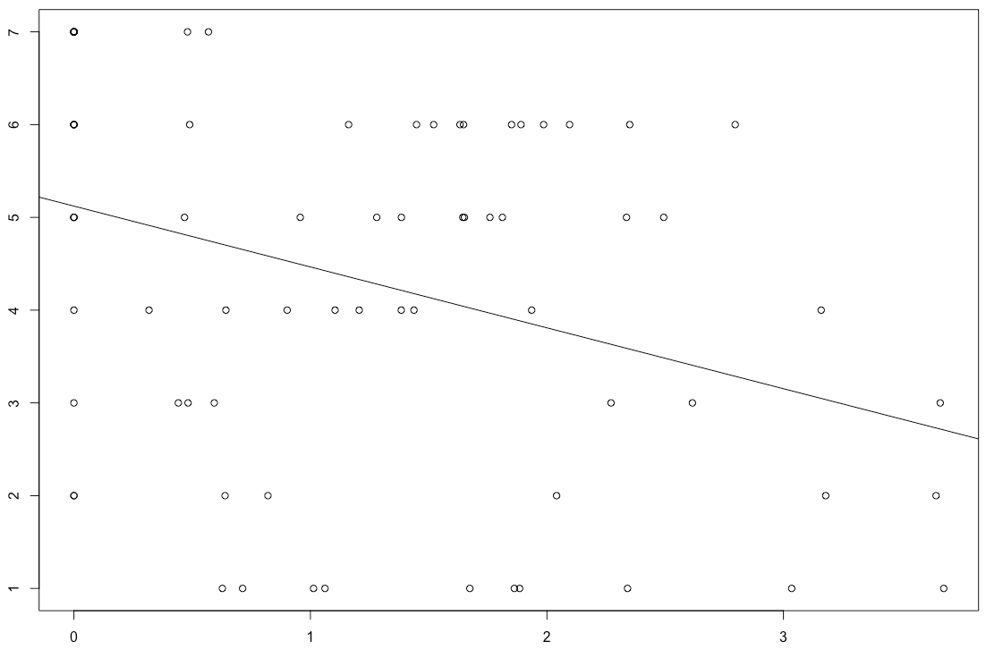
Self-reported Proficiency of Other Lang (Write)
Quotative
p>.05
Approximative
p=0.002, r= -0.349
Discourse marker
p=0.004, r= -0.326
Discourse Particle
p=0.002, r= -0.345
SR Other Write
Approximative
Notes:
### Other Write
cor.test(one, otherwrite)
cor.test(two, otherwrite)
#p = 0.002
#r = -0.349
cor.test(three, otherwrite)
#p = 0.004
#r = -0.326
cor.test(four, otherwrite)
#p = 0.002
#r = -0.345

Slide 9
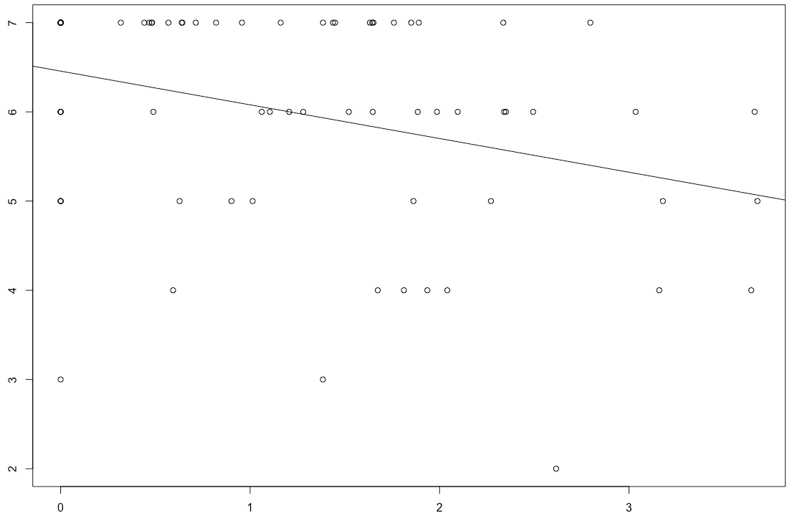
Self-reported Proficiency of Other Lang (Understand)
Quotative, DM, DP
p>.05
Approximative
p=0.004, r= -0.329
SR Other Understand
Approximative
Notes:
### Other Understand
cor.test(one, otherunder)
cor.test(two, otherunder)
#p = 0.004
#r = -0.329
cor.test(three, otherunder)
cor.test(four, otherunder)

Slide 10
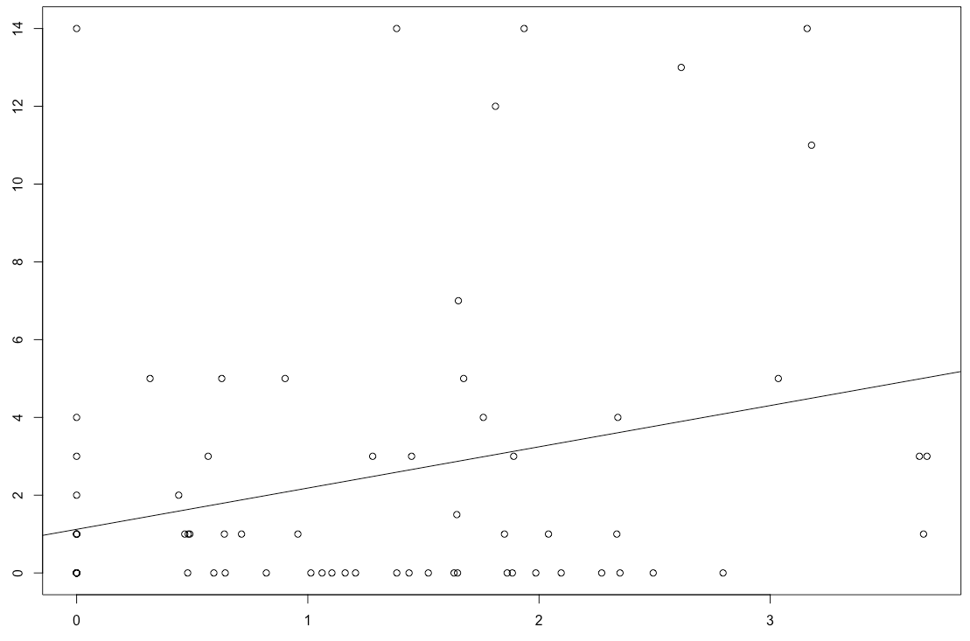
Age Exposed to English and Other Lang
Total Like, Quotative, DM, DP
p>.05
Approximative vs English
p=0.010, r= -0.294
Approximative vs Other Lang
p=0.012, r= 0.288
Age Exposed to Other Lang
Approximative
Notes:
cor.test(two, ageexposedeng)
#p = 0.010
#r = -0.294
cor.test(two, ageexposedother)
#p = 0.012
#r = 0.288

Slide 11
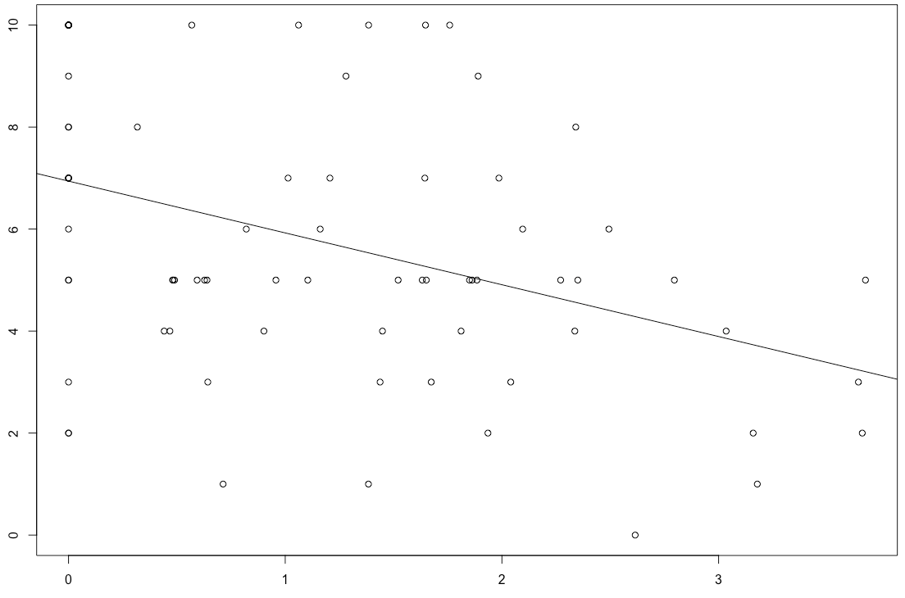
Current Use of Other Lang
Total Like, Quotative, DM, DP
p>.05
Approximative
p=0.0004, r= -0.398
Current Use of Other Lang
Approximative
Notes:
cor.test(one, currentuseother)
cor.test(two, currentuseother)
plot(two, currentuseother)
#p = 0.0004
#r = -0.398
cor.test(three, currentuseother)
cor.test(four, currentuseother)

Slide 12
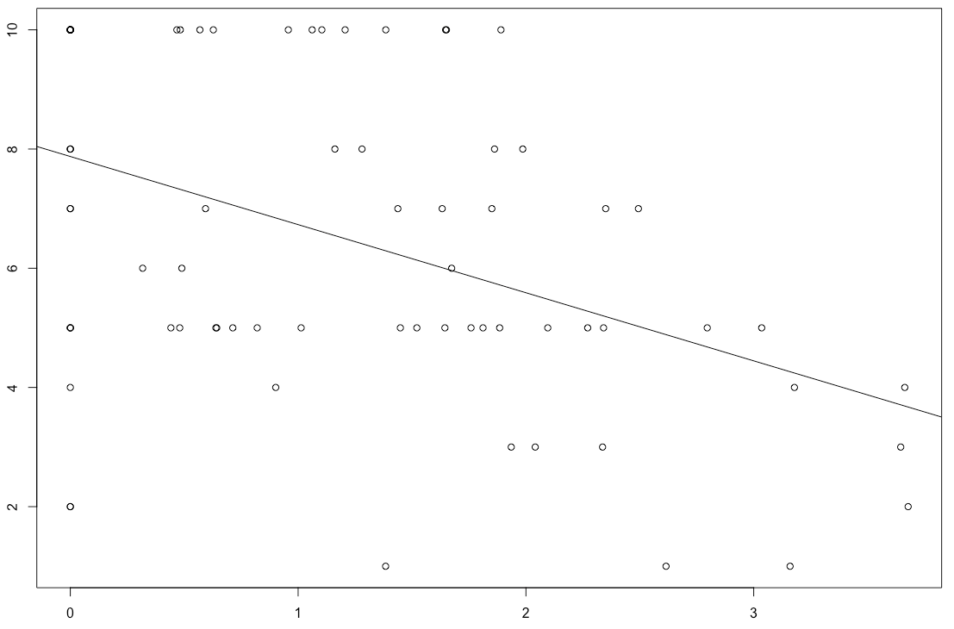
Current Exposure of Other Lang
Total Like, Quotative, DM, DP
p>.05
Approximative
p<.0001, r= -0.441
Current Exposure of Other Lang
Approximative
Notes:
cor.test(total, currentexposother)
cor.test(total, currentuseother)
cor.test(one, currentexposother)
cor.test(two, currentexposother)
plot(two, currentexposother)
#p < .0001
#r = -0.441
cor.test(three, currentexposother)
cor.test(four, currentexposother)

Slide 13
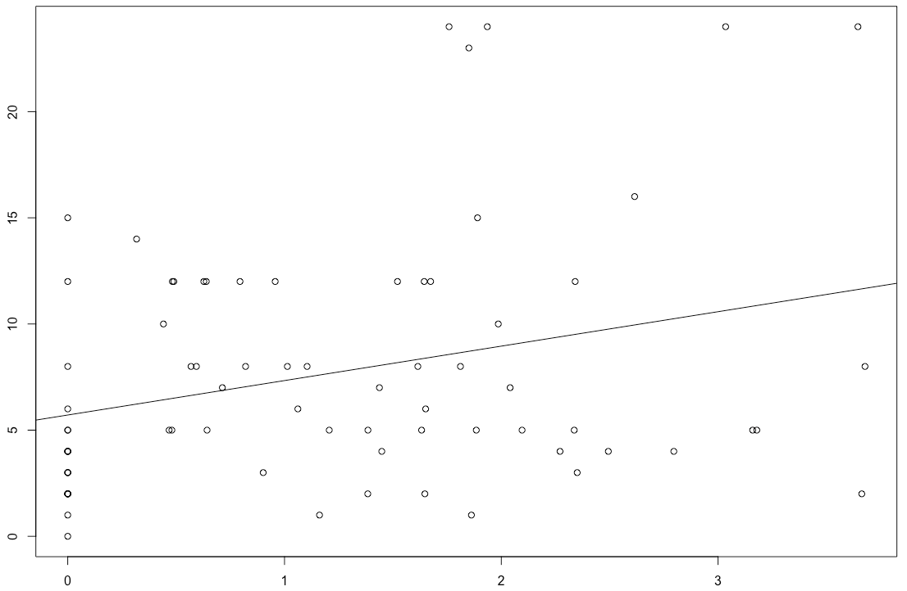
Self-reported Time Speaking English to Friends
Quotative, DM, DP
p>.05
Total Like
p=0.07, r=0.207
Approximative
p=.01, r=0.293
SR Time Speaking Eng to Friends
Approximative
Notes:
cor.test(total, timespeakengfriends)
#p = 0.07
cor.test(one, timespeakengfriends)
cor.test(two, timespeakengfriends)
#p = 0.01
#r = 0.293
cor.test(three, timespeakengfriends)
cor.test(four, timespeakengfriends)

Slide 14
Self-reported Time Speaking Other Lang to Friends
Total Like
p=0.0004, r= -0.400
Quotative
p=0.005, r= -0.317
Approximative
p=0.001, r= -0.366
Discourse Marker
p=0.004, r= -0.325
Discourse Particle
p=0.003, r= -0.336
Notes:
cor.test(total, timespeakotherfriends)
#p = 0.0004
#r = -0.400
cor.test(one, timespeakotherfriends)
#p = 0.005
#r = -0.317
cor.test(two, timespeakotherfriends)
#p = 0.001
#r = -0.366
cor.test(three, timespeakotherfriends)
#p = 0.004
#r = -0.325
cor.test(four, timespeakotherfriends)
#p = 0.003
#r = -0.336

Slide 15
Self-reported Codeswitching
Approximative and CS #2 (Situations)
p=0.016, r= -0.274
Approximative and CS #3 (Topics)
p=0.015, r= -0.276
Notes:
cor.test(two, cs2) Situations
#p = 0.016
#r = -0.274
cor.test(two, cs3) Topics
#p = 0.015
#r = -0.276

Slide 16
Proportion of English Only Files
Total Like
p=0.015, r=0.279
Quotative
p=0.087, r=0.197
Approximative
p=0.003, r=0.334
Discourse Marker
p=0.035, r=0.241
Discourse Particle
p=0.056, r=0.219
Notes:
cor.test(total, propengonly)
#p = 0.015
#r = 0.279
cor.test(one, propengonly)
#p=0.087
#r=0.197
cor.test(two, propengonly)
plot(two, numberengfiles)
#p = 0.003
#r=0.334
cor.test(three, propengonly)
#p=0.035
#r=0.241
cor.test(four, propengonly)
#p=0.056
#r=0.219

Slide 17
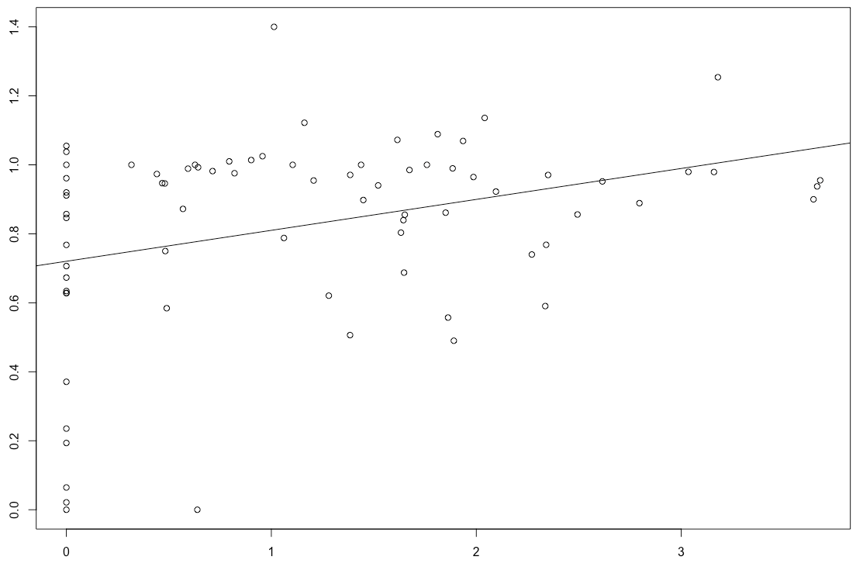
Proportion Eng Only Files
Approximative

Slide 18
Apartment
Total Like
p<.0001, r=0.679
Quotative
p<0.0001, r=0.435
Approximative
p<0.0001, r=0.448
Discourse Marker
p<0.0001, r=0.614
Discourse Particle
p<0.0001, r=0.602
Notes:
cor.test(total, apt)
#p<0.0001
#r=0.679
plot(total, apt)
abline(lm(apt ~ total))
cor.test(one, apt)
#p<0.0001
#r=0.435
cor.test(two, apt)
#p<0.0001
#r=0.448
cor.test(three, apt)
#p<0.0001
#r=0.614
cor.test(four, apt)
#p<0.0001
#r=0.602

Slide 19
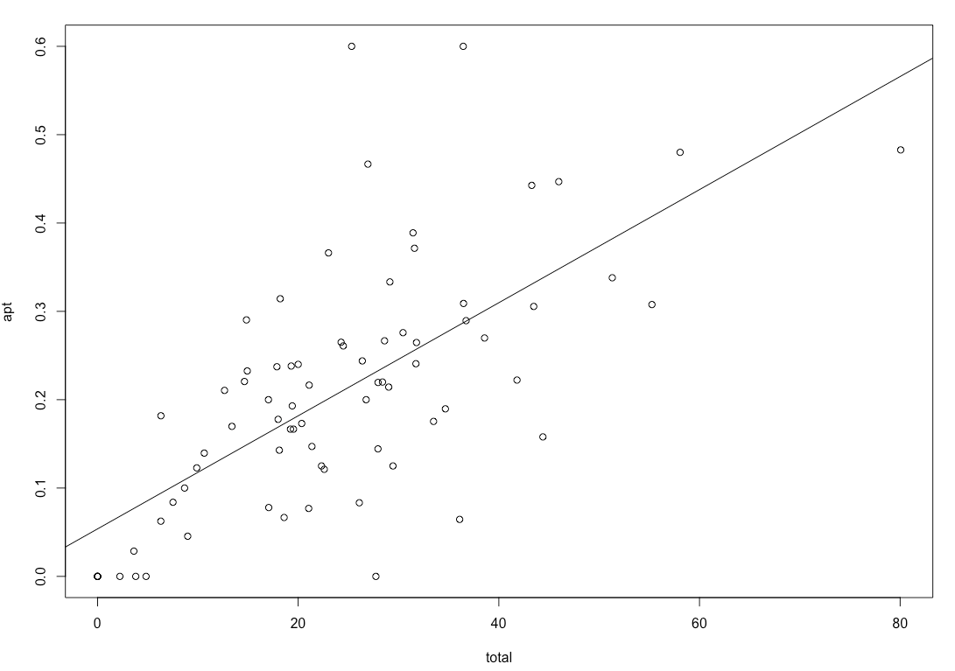
Number Like Files at Apartment
Total Like

Slide 20
Classroom
Total Like, Approx., DM, DP
p>0.05
Quotative
p=0.043, r=0.233
Notes:
cor.test(classroom, total)
cor.test(one, classroom)
#p=0.0425
#r=0.233
cor.test(two, classroom)
cor.test(three, classroom)
cor.test(four, classroom)

Slide 21
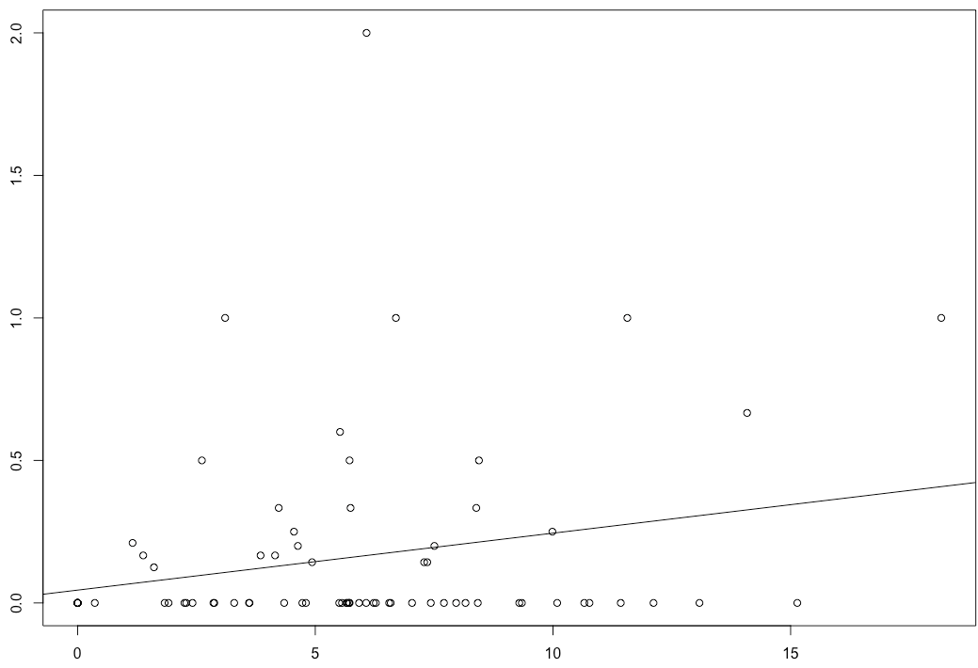
Number Like Files in Classroom
Approximative

Slide 22
In Transit (Vehicle)
Quotative
p>0.05
Total Like
p=0.03, r=0.246
Approximative
p=0.098, r=0.19
Discourse Marker
p=0.042, r=0.233
Discourse Particle
p=0.09, r=0.19
Notes:
cor.test(intransit, total)
#p=0.03
#r=0.246
cor.test(intransit, one)
cor.test(intransit, two)
#p=0.098
#r=0.19
cor.test(intransit, three)
#p=0.042
#r=0.233
cor.test(intransit, four)
#p=0.09
#r=0.19

Slide 23
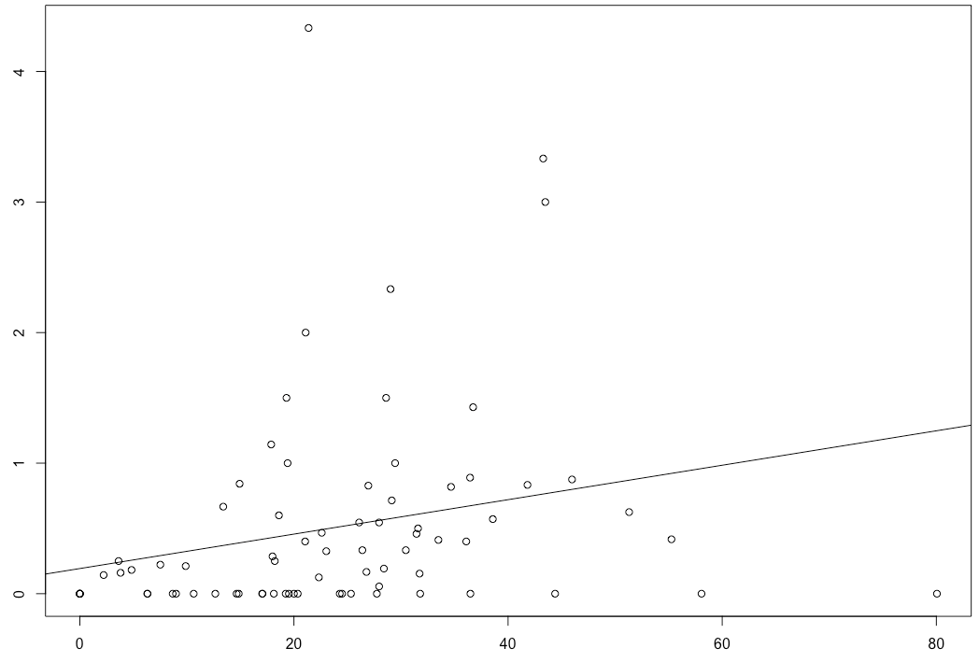
Number Like Files In Transit (Vehicle)
Total Like

Slide 24
Restaurant
Total Like
p=0.002, r=0.339
Quotative
p=0.09, r=0.19
Approximative
p=0.07, r=0.20
Discourse Marker
p=0.028, r=0.251
Discourse Particle
p=0.001, r=0.369
Notes:
cor.test(resto, total)
#p=0.002
#r=0.339
cor.test(resto, one)
#p=0.09
#r=0.19
cor.test(resto, two)
#p=0.07
#r=0.20
cor.test(resto, three)
#p=0.028
#r=0.251
cor.test(resto, four)
#p=0.001
#r=0.369

Slide 25
Other Public Places
Total Like
p<0.0001, r=0.417
Quotative
p=0.002, r=0.348
Approximative
p=0.002, r=0.349
Discourse Marker
p=0.016, r=0.274
Discourse Particle
p<0.001, r=0.408
Notes:
cor.test(otherpublic, total)
#p<0.0001
#r=0.417
cor.test(otherpublic, one)
#p=0.002
#r=0.348
cor.test(otherpublic, two)
#p=0.002
#r=0.349
cor.test(otherpublic, three)
#p=0.016
#r=0.274
cor.test(otherpublic, four)
#p<.001
#r=0.408

